Slide 1
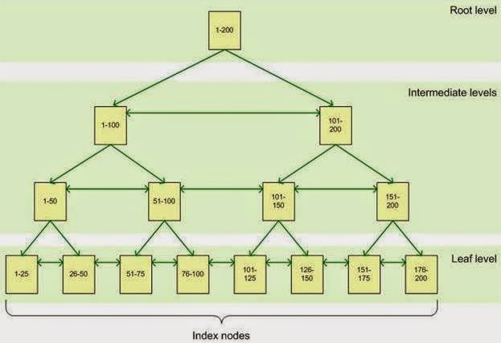
When we create an index, whether clustered or non-clustered, the index is spread across a set of pages, referred to as the index nodes. We call this structure the B-tree structure. The pages are spread across three levels: The root node, the intermediate node, and the leaf nodes. A B-tree index orders rows according to their key values (remember the key is the column or columns you are interested in), and divides this ordered list into ranges. These ranges are organized in a tree structure, with the root node defining a broad set of ranges, and each level below defining a progressively narrower range.
So how does this B tree structure help performance?

Slide 2
Suppose you have a query that is:
select orderid, orders
from Orders
where orderid = 76
When we execute this query, the root node represents the main entry point for queries trying to locate data via the index. From that root node, the data engine negotiates the hierarchy down to the appropriate leaf node, where the actual data resides.
The query engine starts at the root node, and determines if the orderid is between 1-100 or between 101-200. Since going to the right pointer is false, it will navigate down the left path. Then it ask again, if the ordered is between 1-50 or between 51-100. Since going to the left is false, it will navigate to the right. It then ask if the ordered is between 51-75 or between 76-100. Since going to the left is false, it will navigate to the right. From here it will go to the 76-100 leaf node and return the data. As this is a clustered index, the leaf node will contain the entire row of data associated with the key value 76. If this is a non-clustered index, the leaf node will point to the clustered table or heap where the row exists. To be discussed next video. As you can see, we can navigate to the data much faster and read less pages that a full table scan

